Slide 1
The min-cost parallel drone scheduling vehicle routing problem
Implementation and Results obtained
Federico Pellizzaro
Giovanni Zanin

Slide 2
PDSVRP
Parallel Drone Scheduling Vehicle Routing Problem
This paper considers:
Availability of multiple trucks and multiple drones
Indipendence of drones from trucks
Capacity of vehicles
Maximum working time of vehicles
Drones that can't serve multiple customers in a single tour
Deterministic travel times
Objective function based on the distances travelled

Slide 3
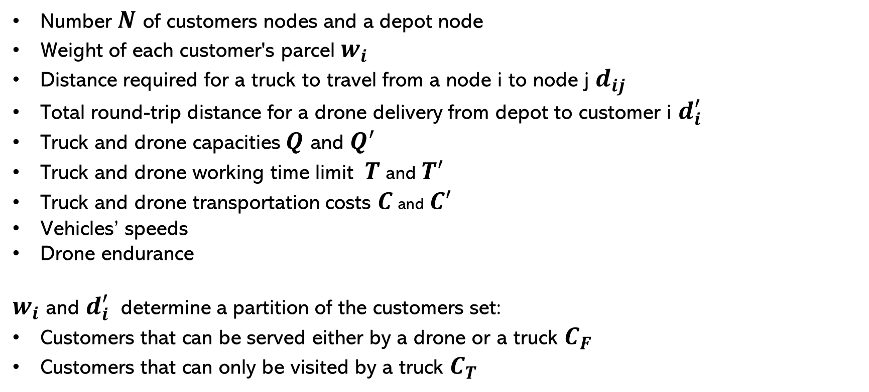
MILP – Parameters
Number $N$ of customers nodes and a depot node
Weight of each customer's parcel $w_{i}$
Distance required for a truck to travel from a node i to node j $d_{ij}$
Total round-trip distance for a drone delivery from depot to customer i $d_{i}^{′}$
Truck and drone capacities $Q$ and $Q^{′}$
Truck and drone working time limit $T$ and $T^{′}$
Truck and drone transportation costs $C$ and $C^{′}$
Vehicles’ speeds
Drone endurance
$w_{i}$ and $d_{i}^{′}$determine a partition of the customers set:
Customers that can be served either by a drone or a truck $C_{F}$
Customers that can only be visited by a truck $C_{T}$

Slide 4
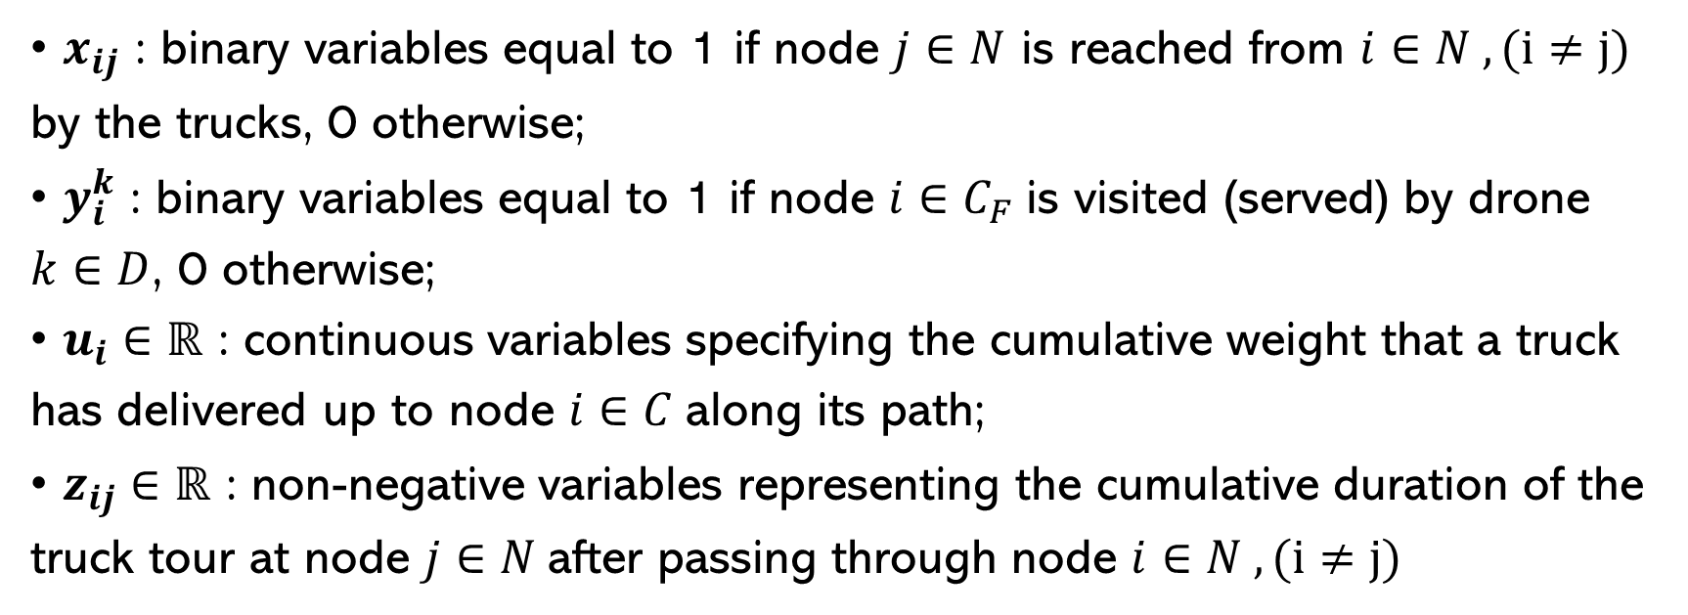
MILP – Decision Variables
• $x_{ij}$ : binary variables equal to 1 if node $j∈N$ is reached from $i∈N , (i≠j)$ by the trucks, 0 otherwise;
• $y_{i}^{k}$ : binary variables equal to 1 if node $i∈C_{F}$is visited (served) by drone $k∈D$, 0 otherwise;
• $u_{i}∈ℝ$ : continuous variables specifying the cumulative weight that a truck has delivered up to node $i∈C$along its path;
• $z_{ij}∈ℝ$ : non-negative variables representing the cumulative duration of the truck tour at node $j∈N$after passing through node $i∈N , (i≠j)$

Slide 5
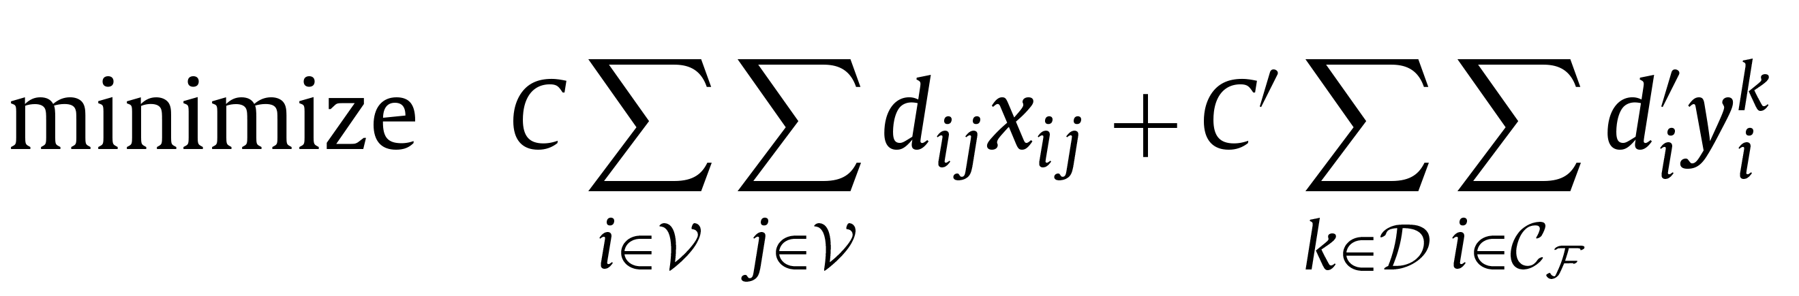
MILP – Formulation
Objective Function

Slide 6
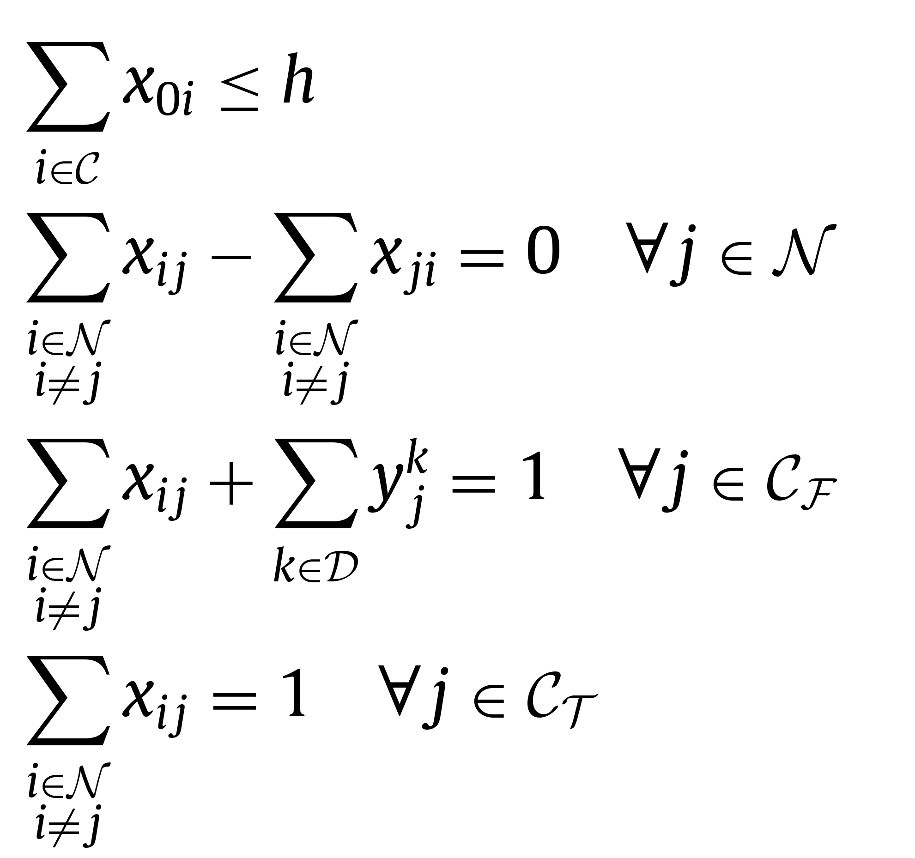
MILP – Formulation
Constraints - 1
(1) → available trucks
(2) → flow conservation
(3) → free customers
(4) → truck-only customers

Slide 7
MILP – Formulation
Constraints - 2
(5)
Miller-Tucker-Zemlin subtour elimination and capacity constraints

Slide 8
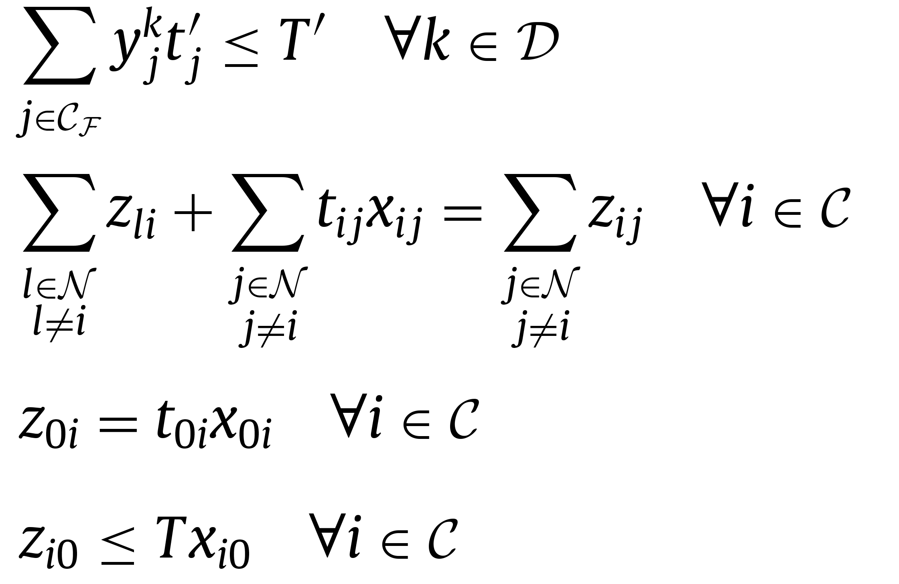
MILP – Formulation
Constraints - 3
(6) → drone time limit
(7)
→ truck time limit
(8)
(9)

Slide 9
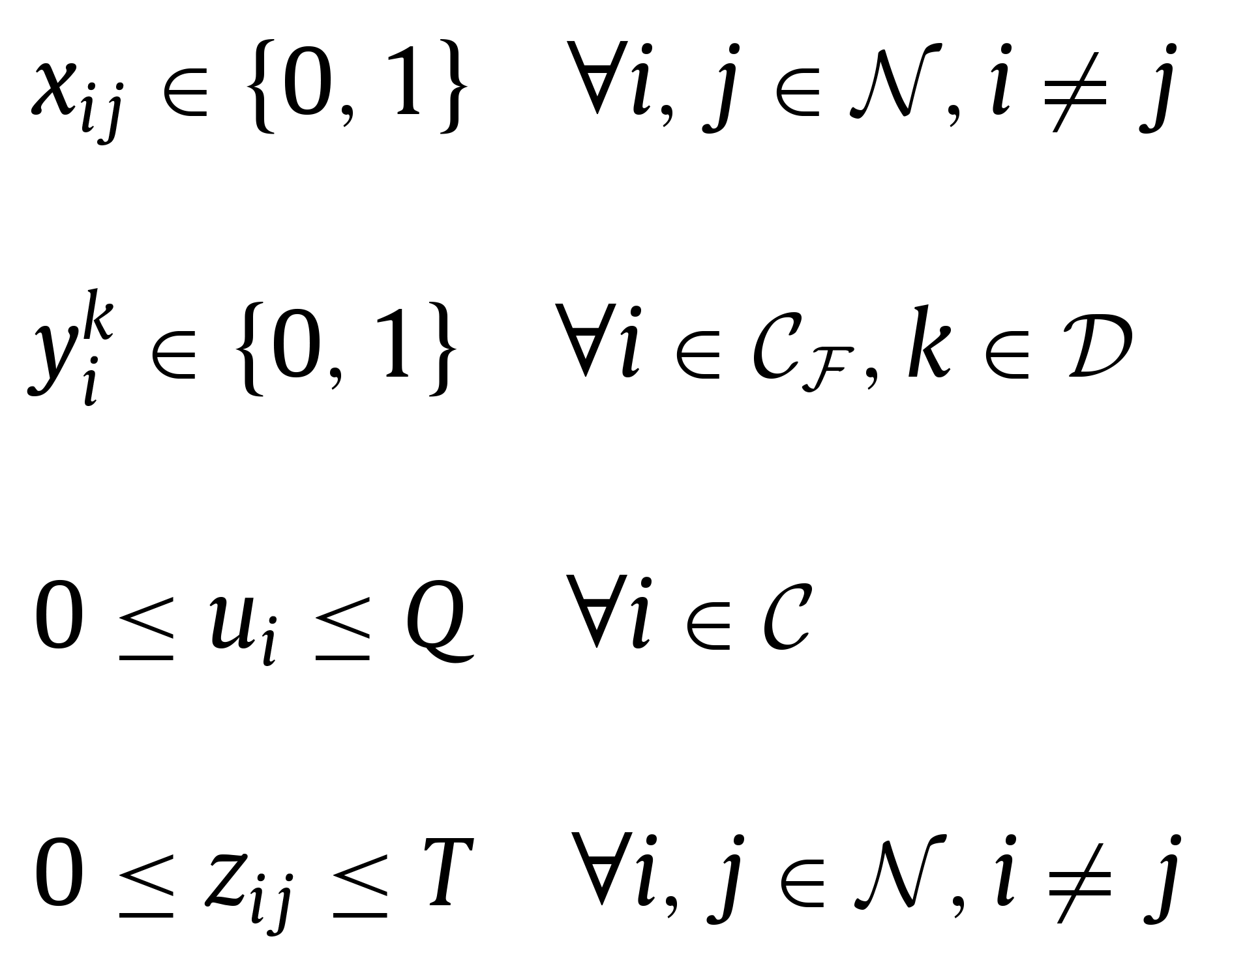
MILP – Formulation
Constraints - 4
(10)
(11)
→ variables domains
(12)
(13)

Slide 10
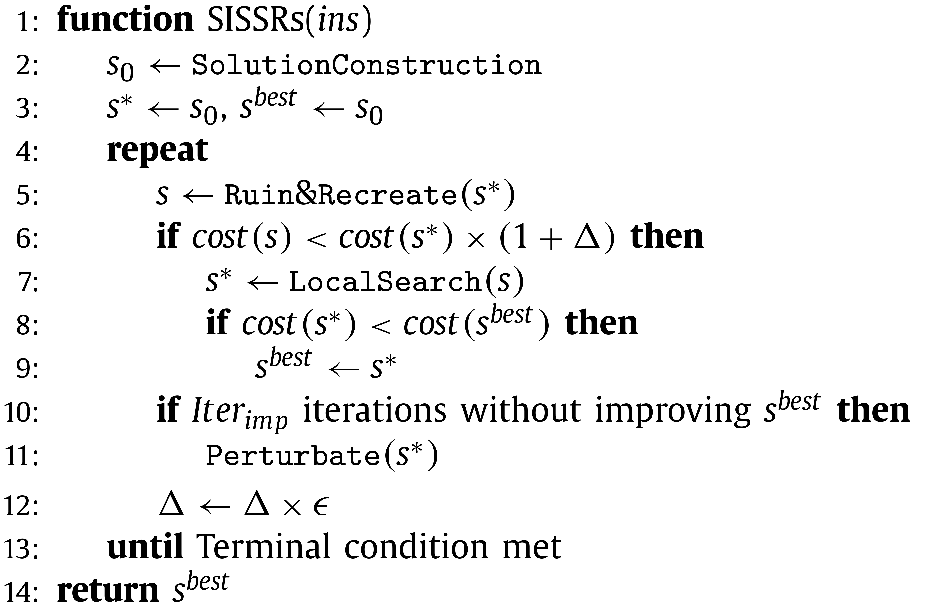
SISSRs
Slack Induction by String and Sweep Removals

Slide 11
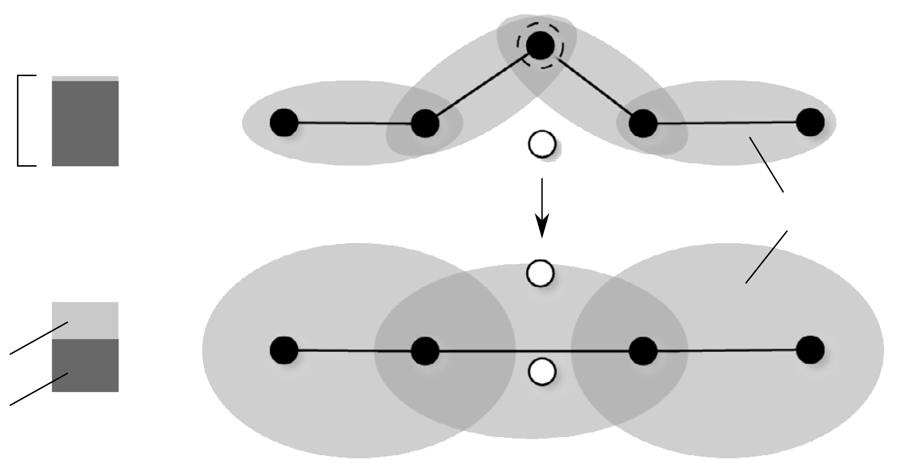
Slack Induction
For Trucks
payload
capacity
spatial slack
capacity slack
occupied slack

Slide 12
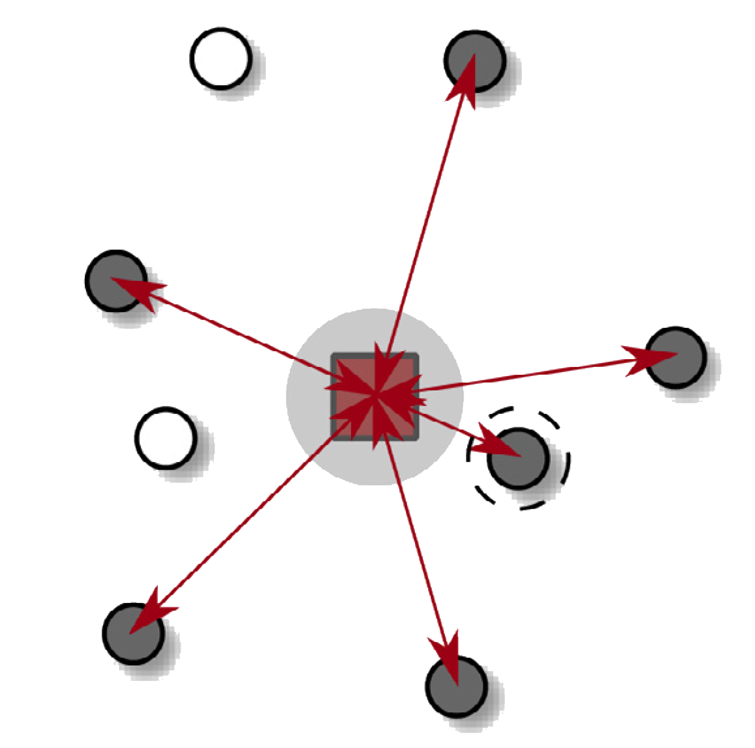
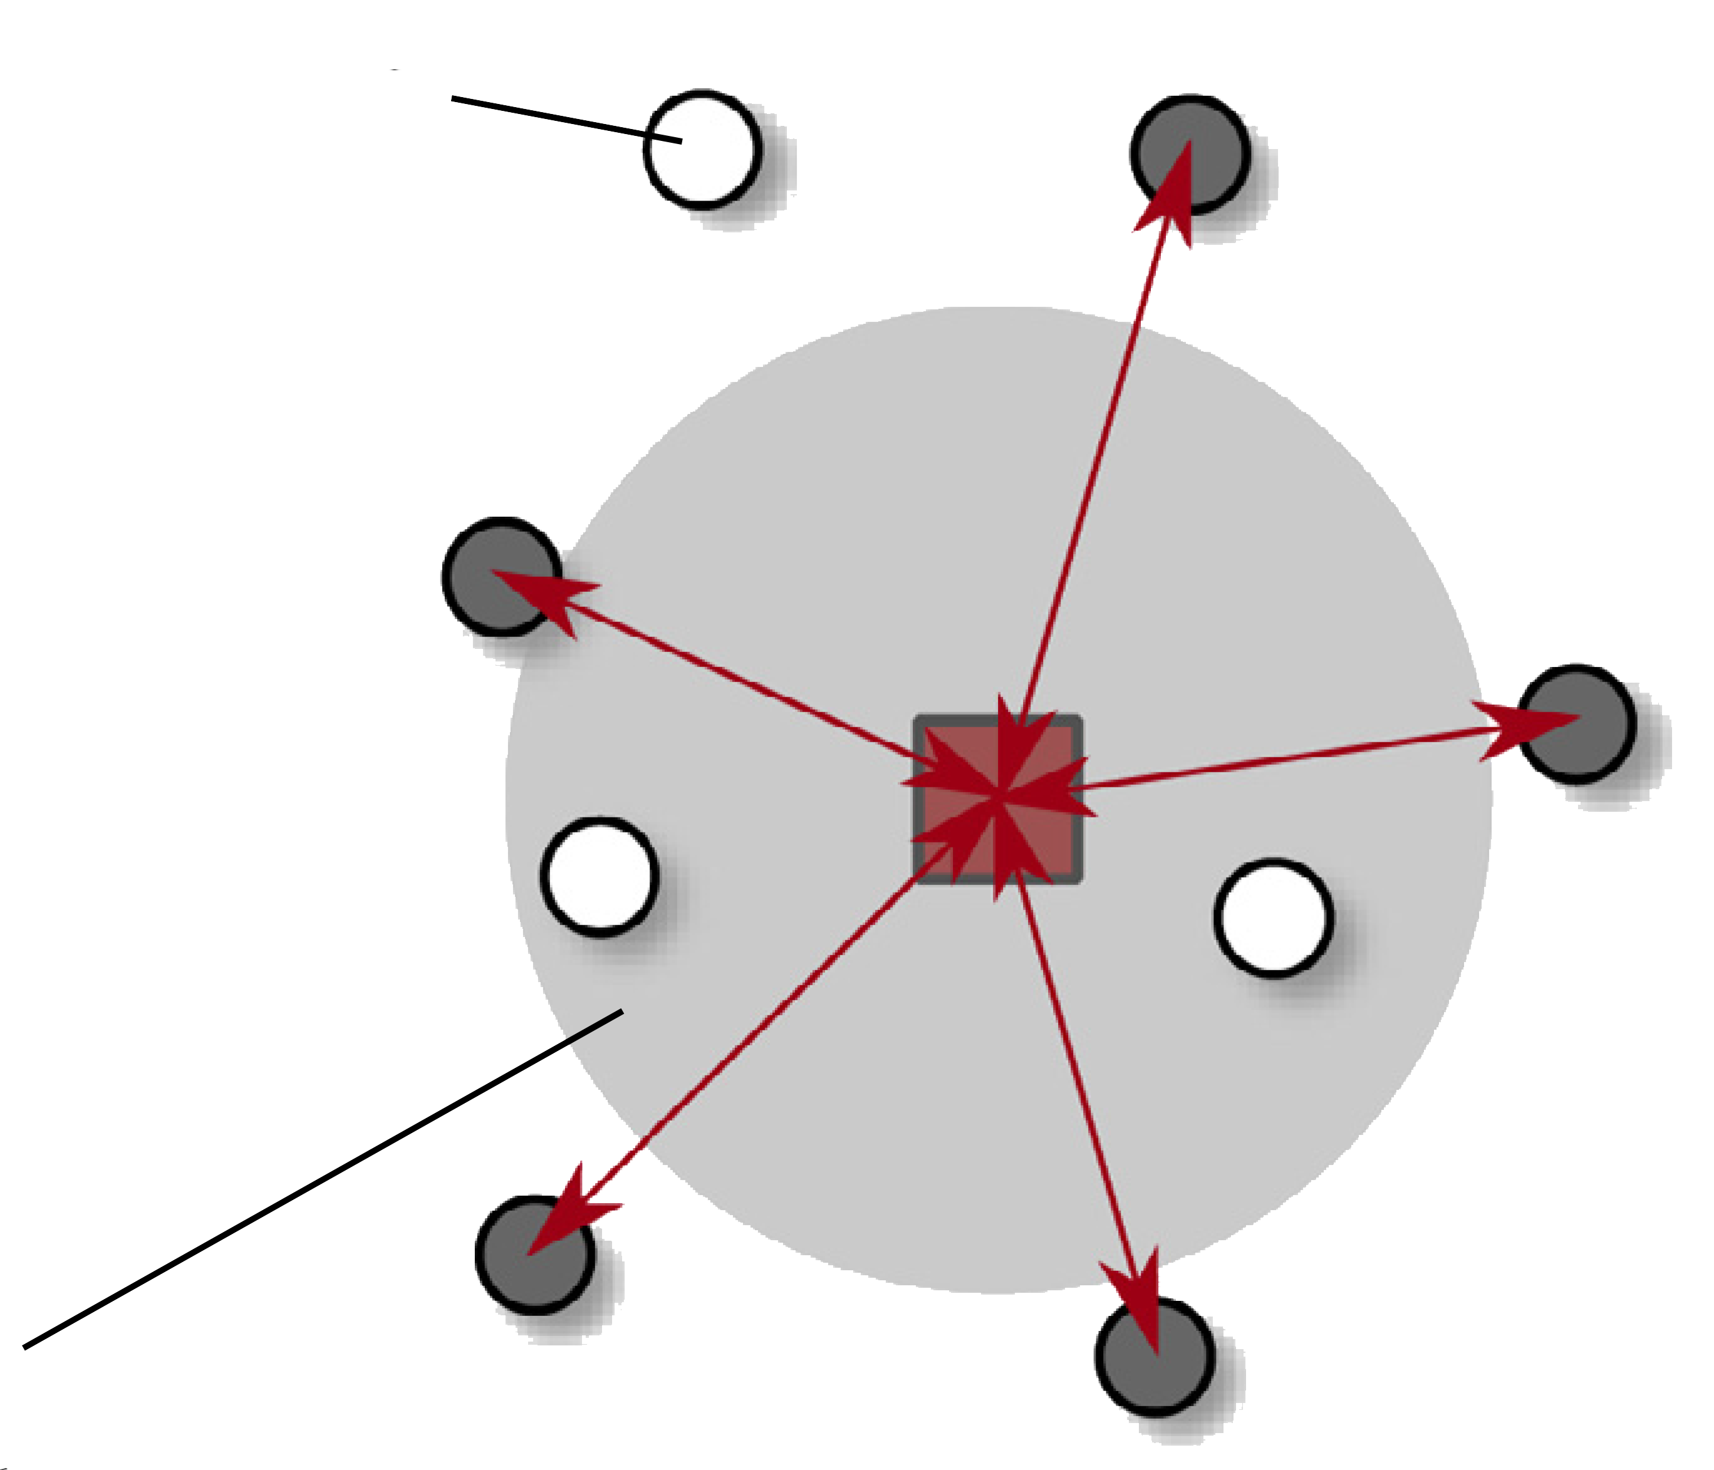
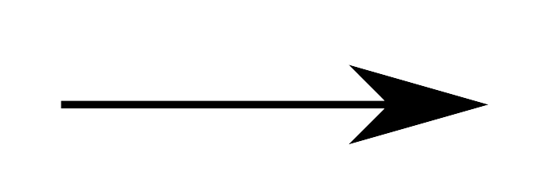
Slack Induction
For Drones
unreachable node
spatial slack

Slide 13

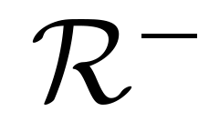
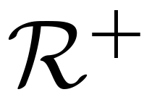
Ruin & Reconstruct ( )
Solution
Solution
Solution
Absent customers
Absent customers
Absent customers
7, 1, 5, 8
Tours
Tours
Tours
Truck tours
Truck tours
Truck tours
1, 5, 4, 3
4, 3
4, 7, 3
6, 8
6
6, 1
Drone tours
Drone tours
Drone tours
7, 9
9
9, 5, 8

Slide 14
– Ruin phase
To ensure the generation of enough slack, the ruin phase should:
Remove a sufficient number of truck customers
Remove adjacent truck customers
Remove strings of truck customers
Remove a sufficient number of drone customers
Sweep a cluster of drone customers
The first three premises are introduced in Slack Induction by String Removals for Vehicle Routing Problems, Christiansen & Berge, 2020 , the last two are introduced in this paper.

Slide 15

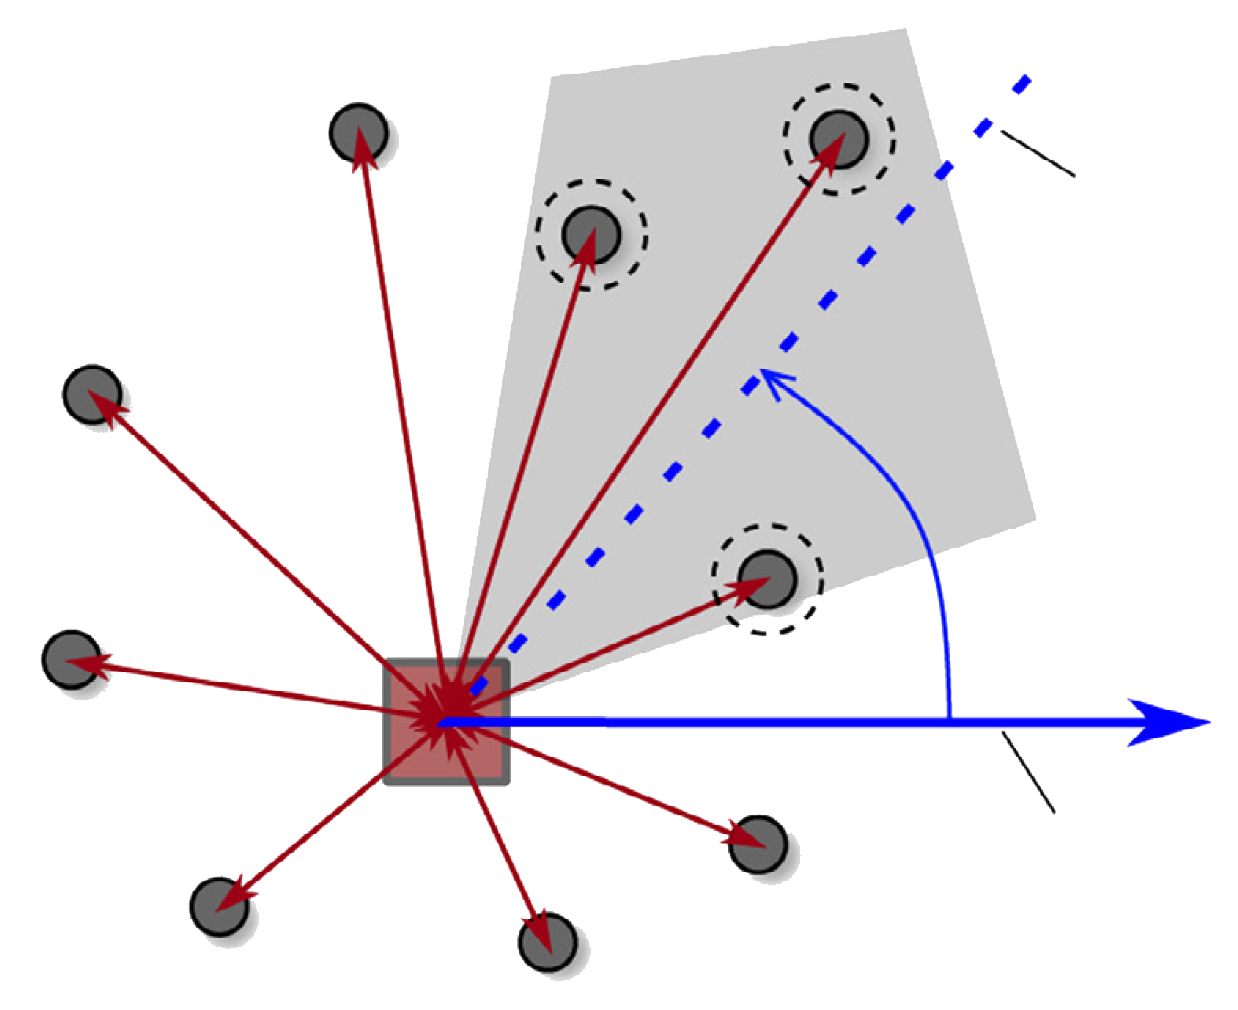
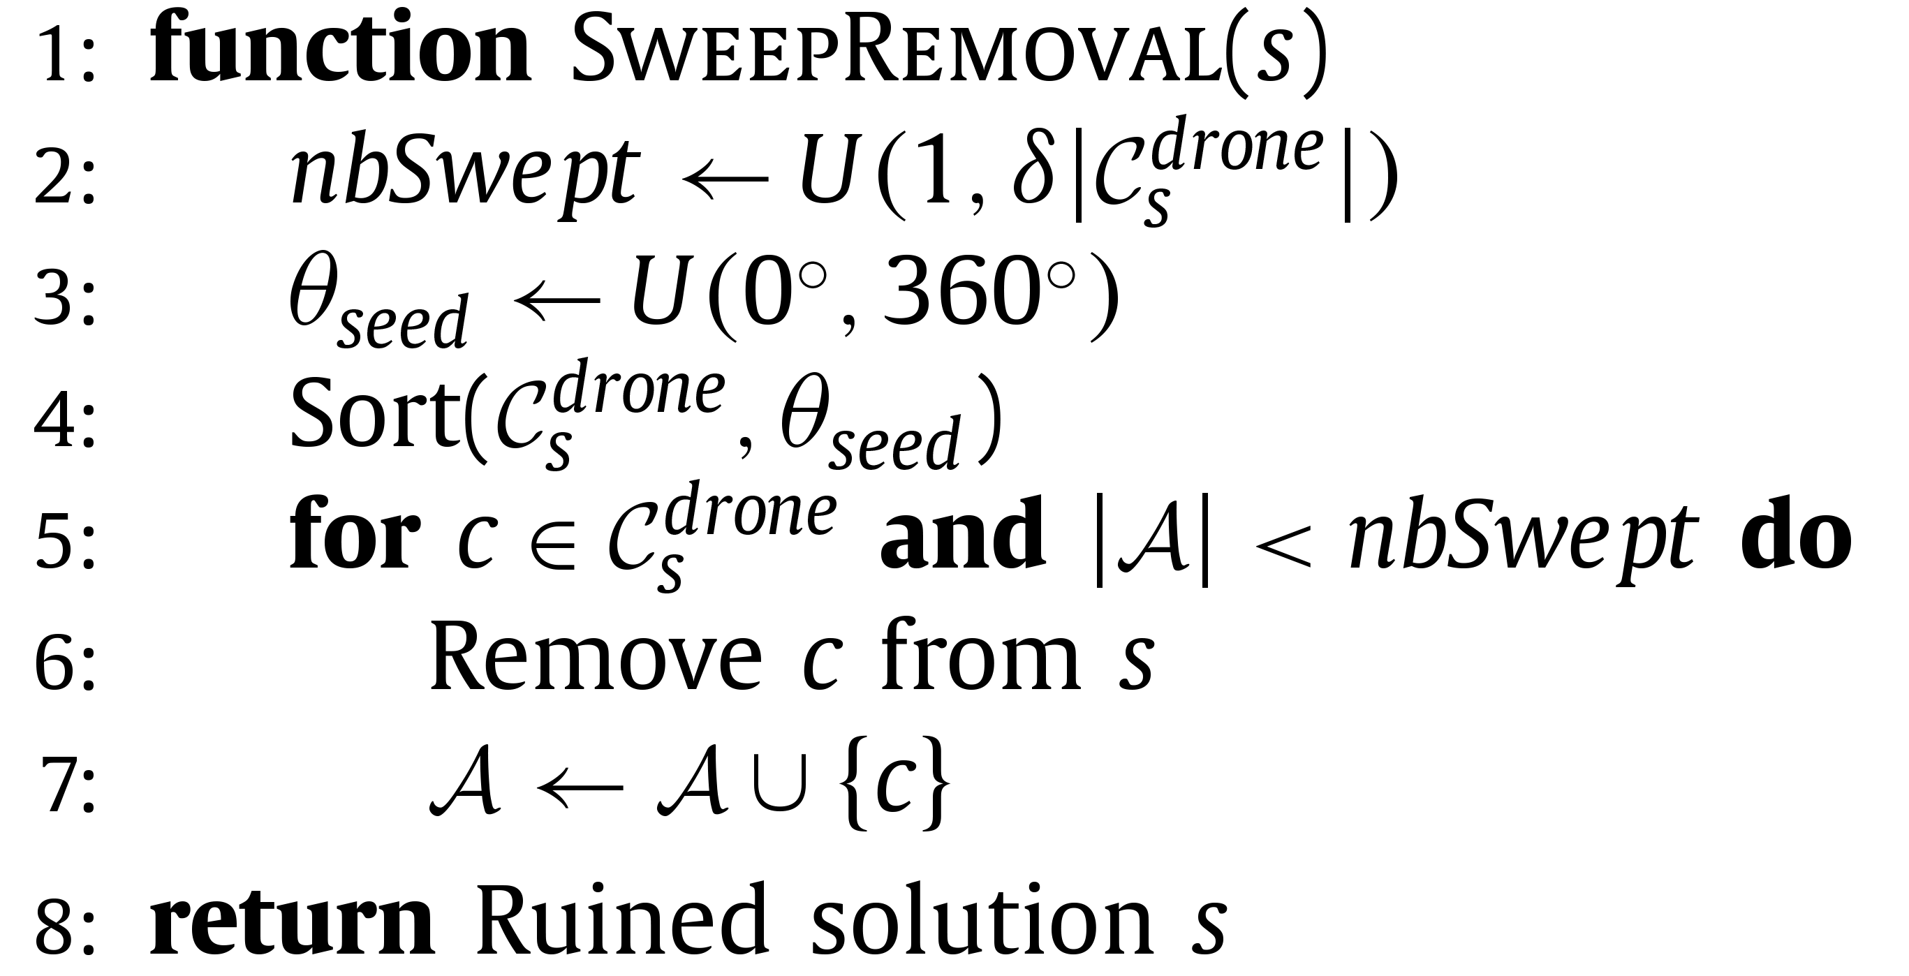
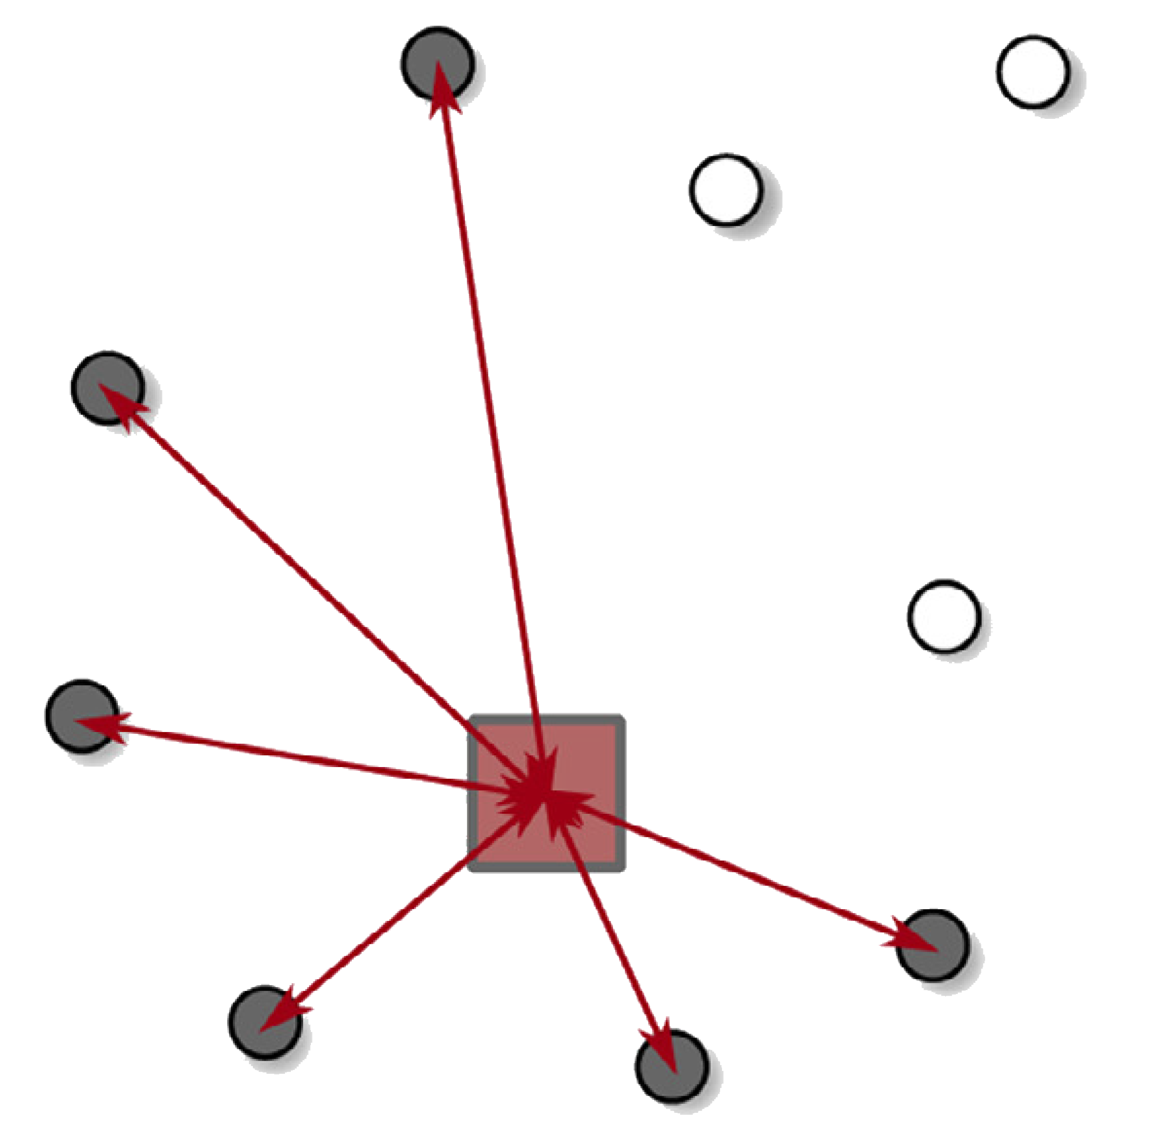
– Sweep removal
l
θ_{axis}
polar axis

Slide 16
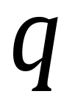
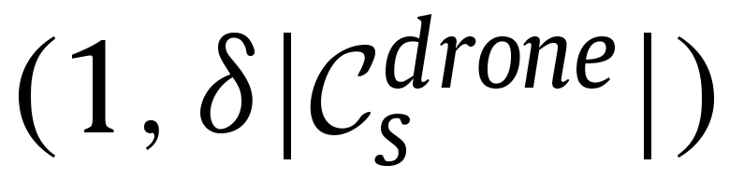
– Random removal
A number is randomly chosen in range between
randomly chosen drone customers are removed from the solution
Each phase starts with either a Sweep removal or a Random removal. The selection in randomic

Slide 17
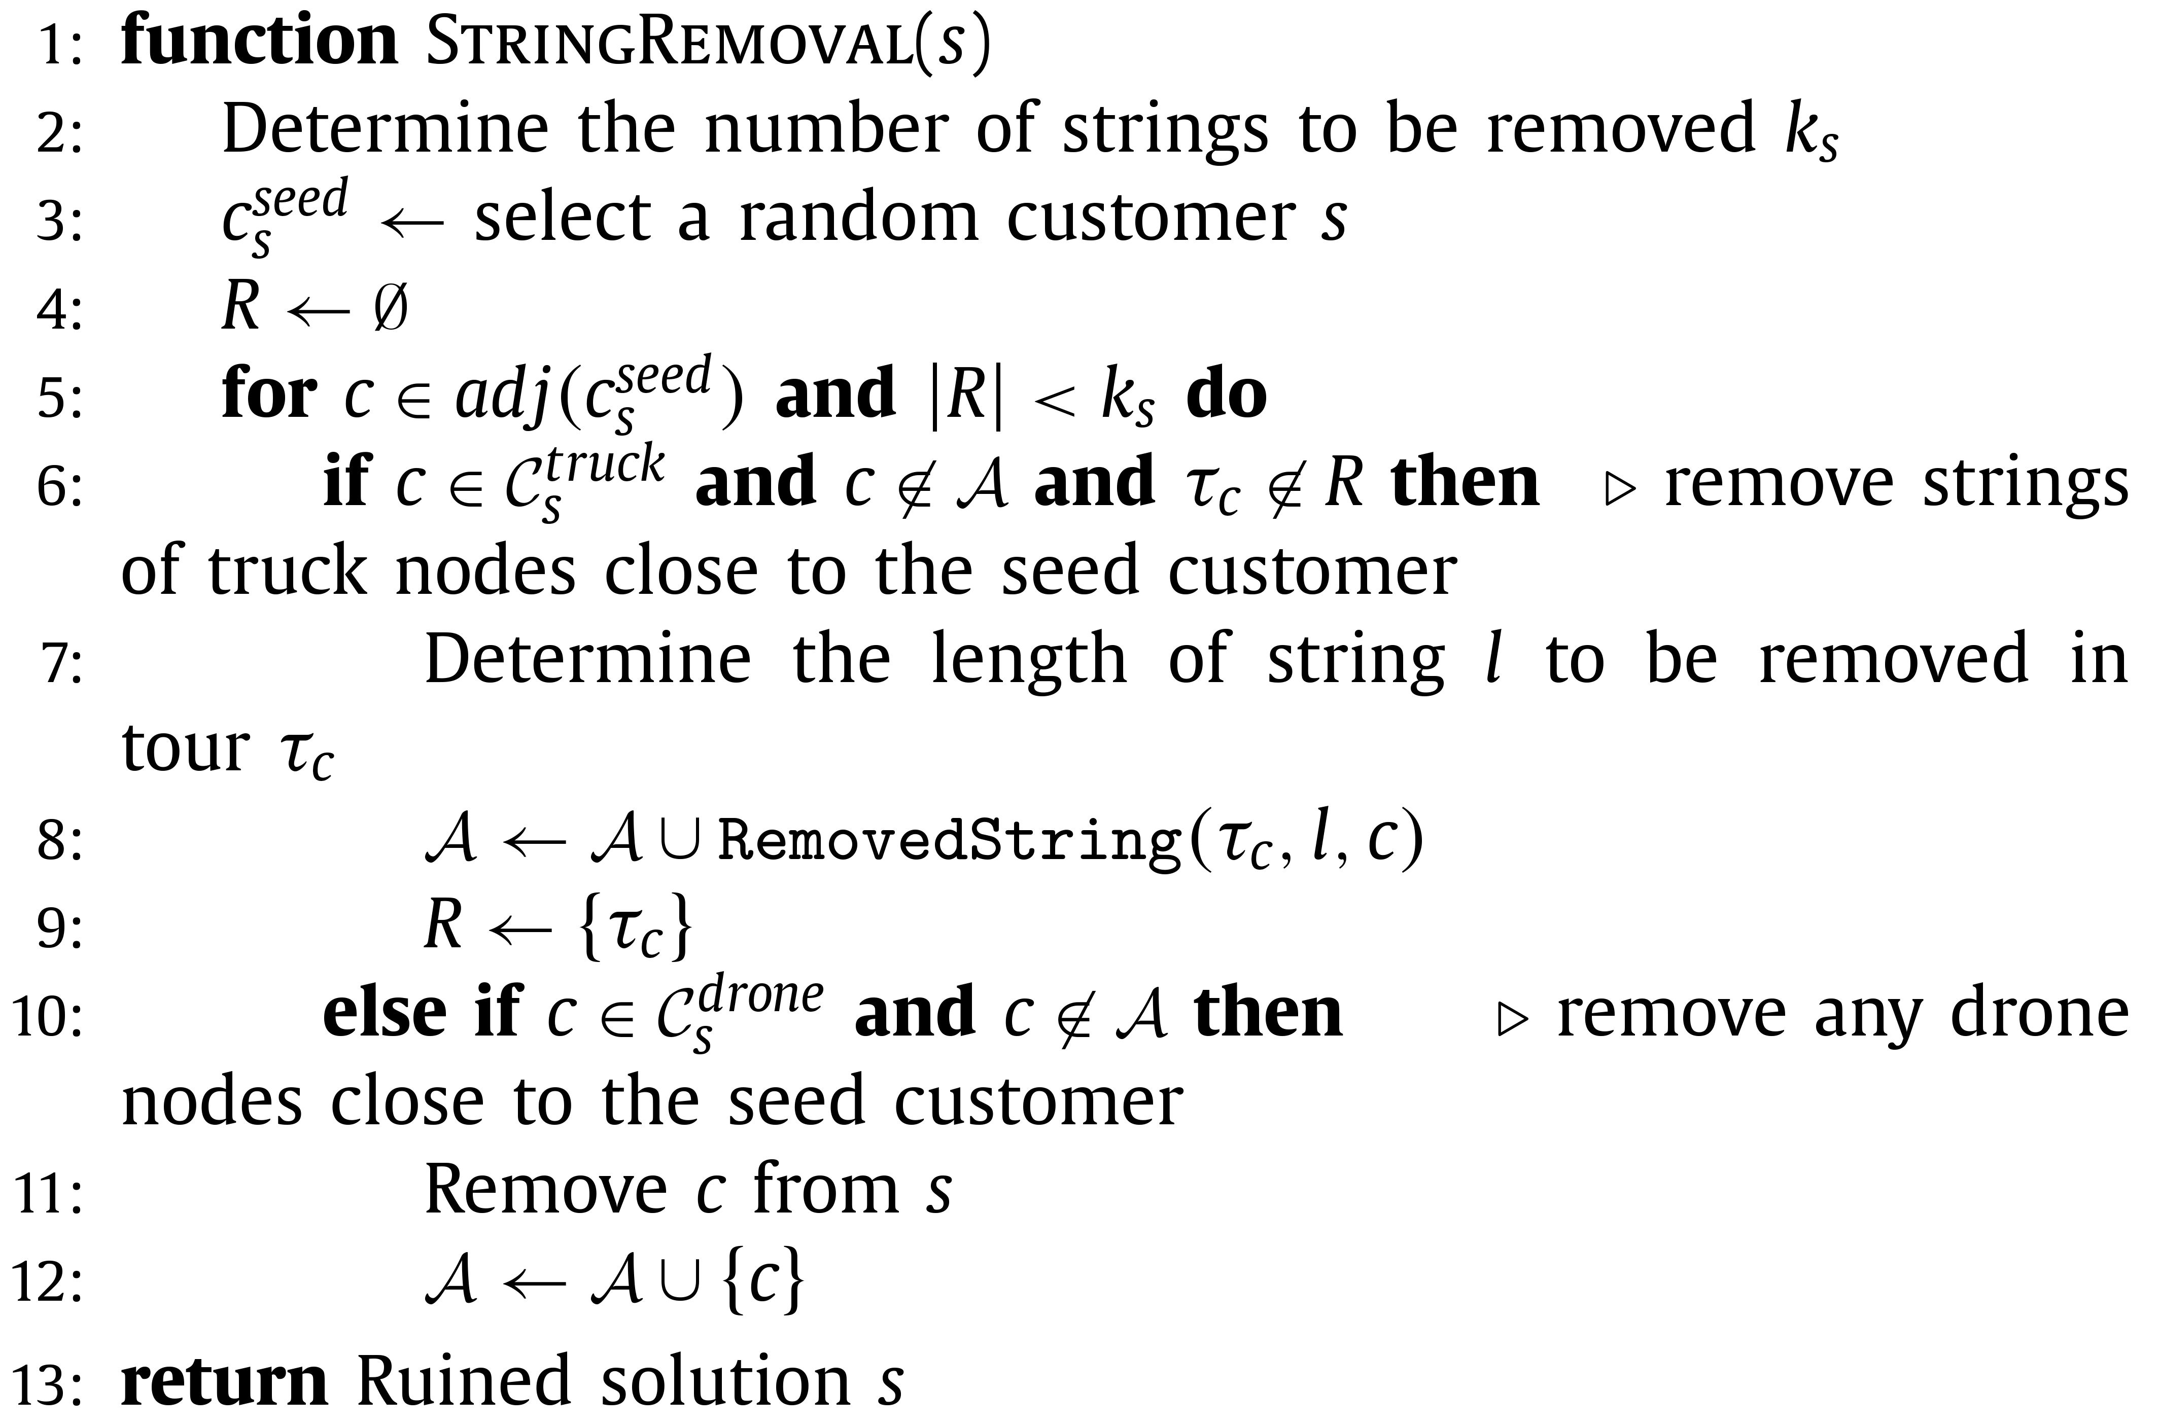
– String removal
The String removal is applied after the initial ruin phase (either Sweep or Random removal)

Slide 18
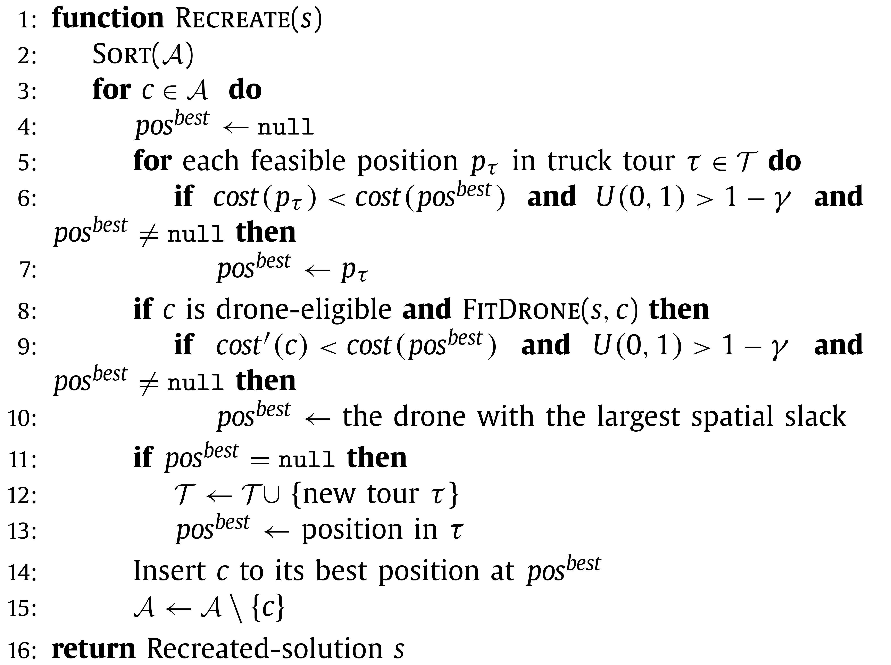
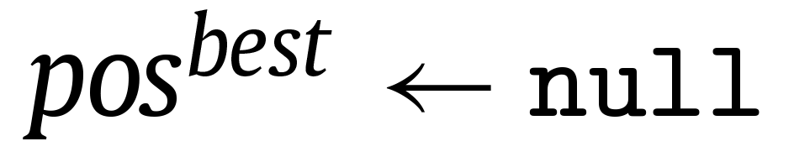
– Reconstruct phase
This check is skipped when
(first iteration)

Slide 19

– Absent customers sorting
Random
Near-dp
Far-dp
Near-tr
Far-tr
Arbitrary order
Closest to the depot first
Farthest to the depot first
Closest to a truck tour first
Farthest to a truck tour first
Each criteria is associated to a weight representing the probability of being selected.

Slide 20
SISSRs – Initial solution
Performed steps:
Solution is initialized with every vehicle tour empty, every customer is placed in A
Local search

Slide 21
SISSRs – Local search
These algorithms are used in order to improve the solution:
RELOCATE
SWAP
2-OPT
2-OPT*
SWAP* (which makes SWAP' redundant)
SHIFT-T
SHIFT-D
Every time an improved solution is found, the local search algorithm is recoursively executed with the new solution found

Slide 22

SISSRs – Local search
RELOCATE
[1, 2, 3, 4, 5, 6]
[1, 3, 4, 2, 5, 6]
6
6
1
1
2
2
5
5
3
3
4
4
RELOCATE is applied to customers served by trucks and involves neighbors that are served in the same truck tour

Slide 23
SISSRs – Local search
SWAP
[1, 2, 3, 4, 5]
[1, 3, 2, 4, 5]
2
2
5
2, 3
5
1
1
3
3
4
4
SWAP is applied to customers served by trucks and involves neighbors that are served in the same truck tour

Slide 24
SISSRs – Local search
2-OPT
[1, 2, 5, 4, 3, 6]
[1, 2, 3, 4, 5, 6]
3
3
1
2
1
2
4
5, 4, 3
4
6
5
6
5
2-OPT is applied to customers served by trucks and involves neighbors that are served in the same truck tour

Slide 25
SISSRs – Local search
2-OPT *
[1, 2, 3, 4, 5],
[A, B, C, D, E]
[1, 2, 3, D, E],
[A, B, C, 4, 5]
5
5
2
4
2
4
1
1
3, C
C
3
C
3
A
A
B
D
E
B
D
E
2-OPT* is applied to customers served by trucks and involves neighbors that are served in a different truck tour

Slide 26
SISSRs – Local search
SWAP *
[1, 2, 3, 4, 5]
[A], [B]
[1, 2, A, 4, 5]
[3], [B]
4
4
2
5
3, A
2
5
1
A
1
A
3
B
3
B
D
D
SWAP* is applied to customers served by trucks and involves neighbors that are served by drones

Slide 27
SISSRs – Local search
SHIFT-T
[1, 2, 3]
[A]
[1, 3]
[A], [2]
2
2
1
3
1
3
D
A
D
A
SHIFT-T is applied to customers served by trucks. The customer will be served by the drone with the largest spatial slack

Slide 28
SISSRs – Local search
SHIFT-D
[1, 2, 3, 4]
[A], [B]
[1, 2, A, 4]
[B]
A
A
2
2
3
4
3
4
1
1
D
B
D
B
SHIFT-D is applied to customers served by drones. The customer will be inserted in a truck tour in the best feasible position.

Slide 29
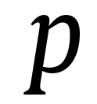
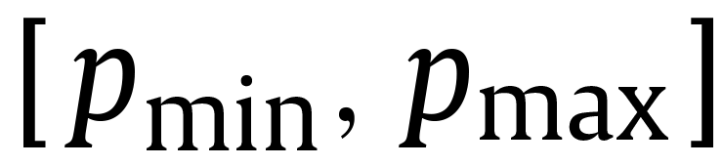
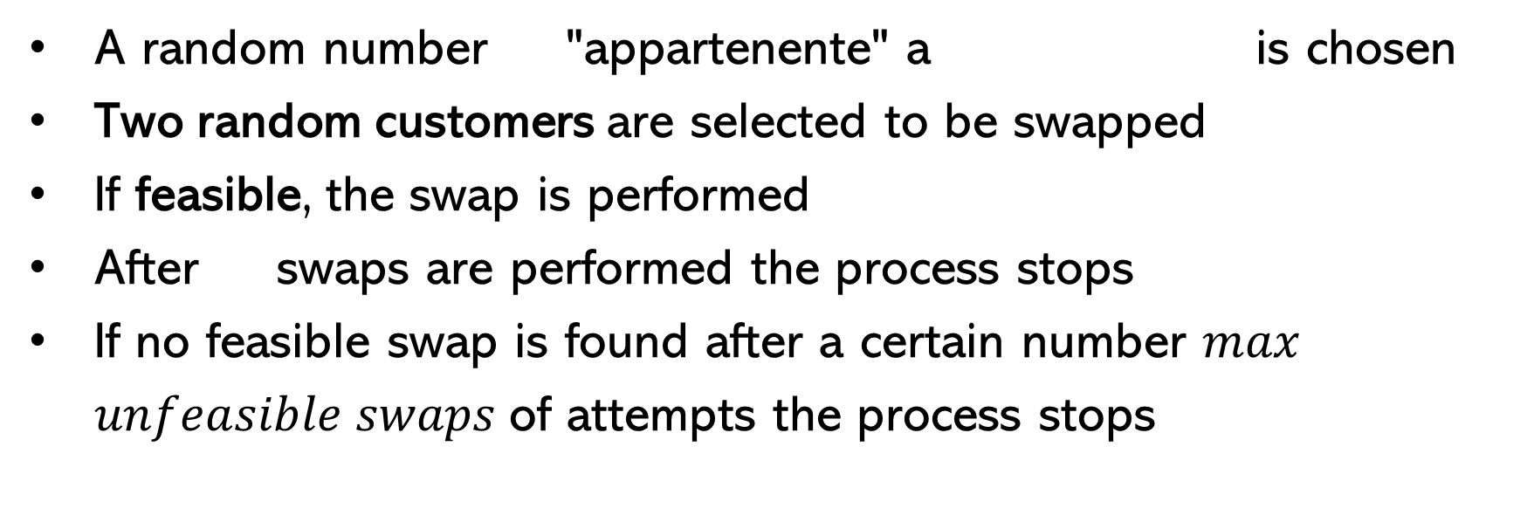
SISSRs – Perturbation
A random number "appartenente" a is chosen
Two random customers are selected to be swapped
If feasible, the swap is performed
After swaps are performed the process stops
If no feasible swap is found after a certain number $max$ $unfeasible swaps$ of attempts the process stops

Slide 30
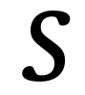
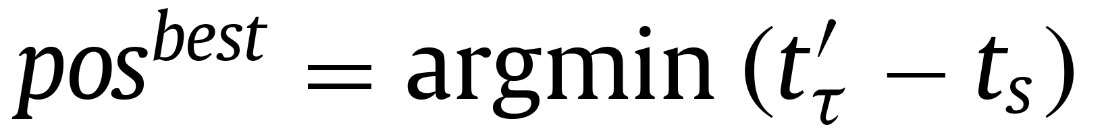
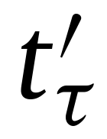

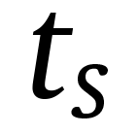
SISSRs – Min time adaptation
Modifications
Objective function
The objective function becomes the makespan, i.e. the duration of the longest tour in a solution
Local search
A move involving two tours is considered improving if the duration of the longest decreases
Best position
: duration of the tour after customer is inserted
: makespan of solution before the insertion
Threshold Acceptance
Between solutions with equal makespan the ones with less total completion time are preferred

Slide 31
Experiments
Instances
We used a subset of the instances of the original paper
The vehicle capacities, the vehicle speeds, the parcel weights, the battery endurance of the drones and the costs ratio were chosen after studying real life examples
The vehicles' time limits were set to plausible values ensuring the customers farthest from the depot colud be visited at least by a truck
Euclidean distances were used for drones
Manhattan distances were used for trucks
Three possibilities for the distribution of the customers: clustered, random and random-clustered
Three possibilities for the depot position: center, edge, random
To test our implementation also on smaller instances (i.e.: 10-20 customers) we created new instances by removing some customers from existing ones

Slide 32
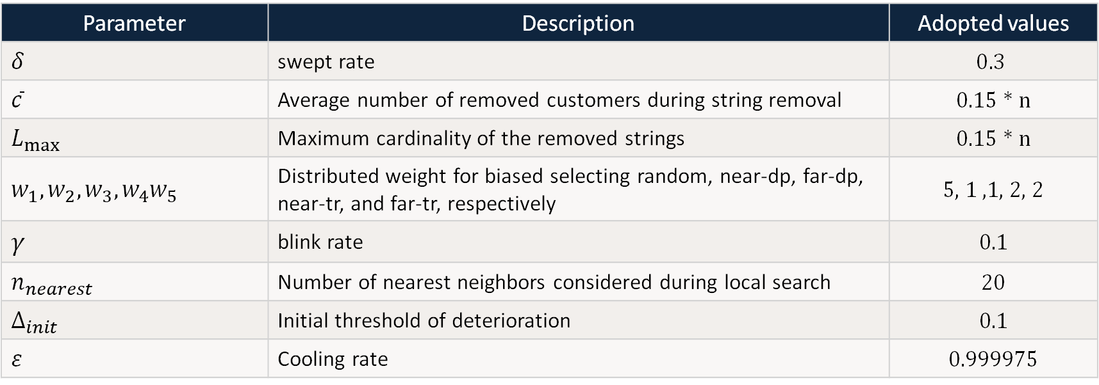
Experiments
Parameters used
Parameter | Description | Adopted values
$$δ$$ | swept rate | $$0.3$$
$$\overline{c}$$ | Average number of removed customers during string removal | 0.15 * n
$$L_{max}$$ | Maximum cardinality of the removed strings | 0.15 * n
$$w_{1},w_{2},w_{3},w_{4}w_{5}$$ | Distributed weight for biased selecting random, near-dp, far-dp, near-tr, and far-tr, respectively | 5, 1 ,1, 2, 2
$$γ$$ | blink rate | 0.1
$$n_{nearest}$$ | Number of nearest neighbors considered during local search | 20
$$∆_{init}$$ | Initial threshold of deterioration | 0.1
$$ε$$ | Cooling rate | 0.999975

Slide 33
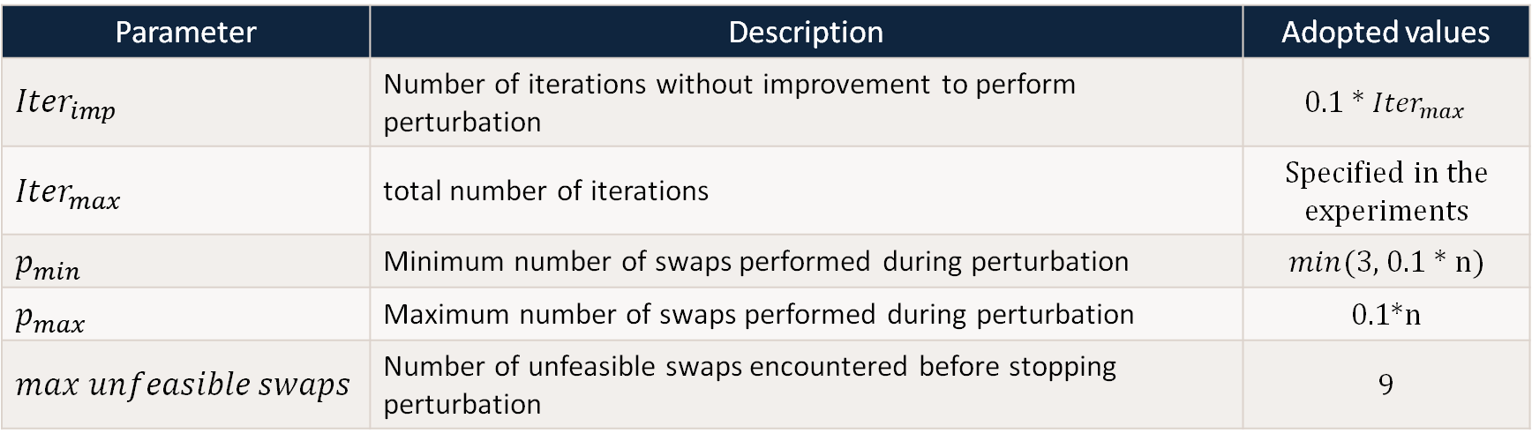
Experiments
Parameters used
Parameter | Description | Adopted values
$${Iter}_{imp}$$ | Number of iterations without improvement to perform perturbation | 0.1 * ${Iter}_{max}$
$${Iter}_{max}$$ | total number of iterations | Specified in the experiments
$$p_{min}$$ | Minimum number of swaps performed during perturbation | $min$(3, 0.1 * n)
$$p_{max}$$ | Maximum number of swaps performed during perturbation | 0.1*n
$max$ $unfeasible swaps$ | Number of unfeasible swaps encountered before stopping perturbation | 9

Slide 34
Experiments – Impact of components
Specifications
9 instances of 30 customers
5000 iterations
11th Gen Intel(R) Core(TM) i7-1165G7 @2.80GHz
Observations
By testing some small instances, it can be observed that local search is the component with the most impact
Variant | Average cost obtained | Average execution time (in seconds)
SISSRs | 123.59 | 250.75
SISSRs without local search | 161.86 | 58.77
SISSRs without threshold acceptance | 135.13 | 78.36
SISSRs without perturbation | 122.33 | 275.41
SISSRs without random removal | 123.37 | 329.75
SISSRs without sweep removal | 124.09 | 276.77

Slide 35
Experiments – Small instances
Specifications
27 instances of 20 customers
1000 iterations
Gurobi was used for comparison
12th Gen Intel(R) Core(TM) i5-12450H @2.00 GHz
Observations
7 times SISSRs reached the same solution of the solver
12 times the gap was <5%
5 times the solver has reached the time limit
Depot in center position encourages the use of drones
When depot is not in center position instances appear harder to solve
The gap from which SISSRs starts has a large range of values
Instance | Cost solver | SISSRs gap from solver | Initial solution gap | Solver execution time | SISSRs execution time | #drone eligible customers | #customers served by drones | #trucks used
20-c-0-c | 71.75 | 0.00% | 2.93% | 3600.00 | 31.18 | 15 | 8 | 2
20-c-0-e | 146.07 | 0.00% | 0.31% | 3600.00 | 36.54 | 6 | 1 | 3
20-c-0-r | 87.03 | 13.22% | 61.42% | 3600.00 | 27.84 | 12 | 3 | 2

Slide 36
Experiments – Small instances
Instance | Cost solver | SISSRs gap from solver | Initial solution gap | Solver execution time | SISSRs execution time | #drone eligible customers | #customers served by drones | #trucks used
20-c-1-c | 13.12 | 0.00% | 340.17% | 0.20 | 12.37 | 18 | 16 | 1
20-c-1-e | 98.98 | 72.75% | 79.51% | 3600.00 | 50.77 | 12 | 6 | 2
20-c-1-r | 52.11 | 0.00% | 53.42% | 8.71 | 8.73 | 17 | 9 | 1
20-c-2-c | 67.04 | 0.00% | 1.72% | 345.95 | 13.59 | 18 | 14 | 2
20-c-2-e | 105.34 | 53.80% | 54.35% | 2488.70 | 60.70 | 14 | 6 | 2
20-c-2-r | 81.73 | 2.02% | 2.02% | 3600.00 | 17.24 | 17 | 5 | 2
20-r-0-c | 79.37 | 4.35% | 26.24% | 4.05 | 6.45 | 16 | 13 | 2
20-r-0-e | 98.92 | 145.77% | 145.90% | 10.74 | 25.25 | 8 | 6 | 2
20-r-0-r | 94.23 | 48.08% | 111.41% | 1.09 | 20.01 | 11 | 10 | 2
20-r-1-c | 34.42 | 0.00% | 0.00% | 0.57 | 10.94 | 17 | 14 | 1
20-r-1-e | 119.19 | 89.80% | 92.00% | 0.26 | 43.98 | 9 | 6 | 2
20-r-1-r | 87.52 | 20.79% | 20.79% | 3.35 | 5.68 | 15 | 9 | 2

Slide 37
Experiments – Small instances
Instance | Cost solver | SISSRs gap from solver | Initial solution gap | Solver execution time | SISSRs execution time | #drone eligible customers | #customers served by drones | #trucks used
20-r-2-c | 26.20 | 204.42% | 204.42% | 0.14 | 6.17 | 19 | 19 | 1
20-r-2-e | 92.52 | 145.70% | 208.20% | 45.42 | 21.45 | 10 | 7 | 2
20-r-2-r | 86.46 | 83.82% | 86.62% | 3.21 | 11.46 | 12 | 8 | 2
20-rc-0-c | 76.80 | 4.87% | 23.39% | 4.99 | 7.73 | 17 | 12 | 2
20-rc-0-e | 109.39 | 65.35% | 70.08% | 11.67 | 24.42 | 10 | 6 | 3
20-rc-0-r | 92.59 | 56.59% | 56.59% | 3.37 | 28.85 | 13 | 7 | 2
20-rc-1-c | 33.48 | 0.00% | 3.66% | 0.54 | 11.44 | 18 | 15 | 1
20-rc-1-e | 107.90 | 60.47% | 96.87% | 2.00 | 41.18 | 8 | 4 | 2
20-rc-1-r | 70.86 | 23.58% | 37.51% | 38.33 | 5.74 | 17 | 8 | 2
20-rc-2-c | 48.76 | 2.08% | 2.08% | 1.89 | 8.89 | 17 | 15 | 1
20-rc-2-e | 93.59 | 98.66% | 99.40% | 111.24 | 31.91 | 11 | 7 | 2
20-rc-2-r | 89.23 | 0.93%% | 37.63% | 196.93 | 10.80 | 11 | 8 | 2

Slide 38
Experiments – Medium instances
Specifications
9 instances of 50 customers
1000 iterations
10 repetitions for each instance
12th Gen Intel(R) Core(TM) i5-12450H @2.00 GHz
Observations
SISSRs seems to have consistent performances as the gap from the best solution found with the heuristic is on average <8%
Depot in center position encourages the use of drones
When depot is not in center position instances appear harder to solve
Instance | Best cost found | Average gap | Average initial gap | Average execution time | #drone eligible customers | #customers served by drones | #trucks used
50-c-1-c | 84.00 | 0.25% | 17.47% | 60.75 | 42 | 16 | 2
50-c-1-e | 133.57 | 4.17% | 31.67% | 169.40 | 41 | 6 | 3
50-c-1-r | 152.16 | 0.31% | 20.93% | 82.26 | 41 | 11 | 3
50-r-1-c | 179.89 | 1.63% | 16.91% | 39.76 | 41 | 14 | 4
50-r-1-e | 216.97 | 5.50% | 35.66% | 75.53 | 24 | 10 | 3

Slide 39
Experiments – Medium instances
Instance | Best cost found | Average gap | Average initial gap | Average execution time | #drone eligible customers | #customers served by drones | #trucks used
50-r-1-r | 235.62 | 2.37% | 16.76% | 55.32 | 33 | 15 | 4
50-rc-1-c | 124.98 | 7.87% | 25.94% | 44.74 | 42 | 16 | 3
50-rc-1-e | 201.62 | 0.45% | 18.68% | 58.87 | 27 | 11 | 3
50-rc-1-r | 173.16 | 0.45% | 14.85% | 89.18 | 37 | 14 | 3

Slide 40
Experiments – Sensitivity analysis
A sensitivity test was conducted to study, with which parameters, the usage of the drones leaded to greater cost reduction
A decision tree regressor was trained with this aim on a dataset of 300 newly generated instances
The chosen features were: the number of customers (range [10,100]), the grid size (range [20,40]), the number of drones available (range [1,20]), the hours of battery endurance of the drone (range [0.25, 1.00]) and the cost rate between drones and trucks (range [10,50])
The other parameters (speeds, capacities and time limits) were kept constant for each instance
The dependent variable ’’saving cost’’ was the difference between the cost of the solution with and without drones available (computed with SISSRs)

Slide 41
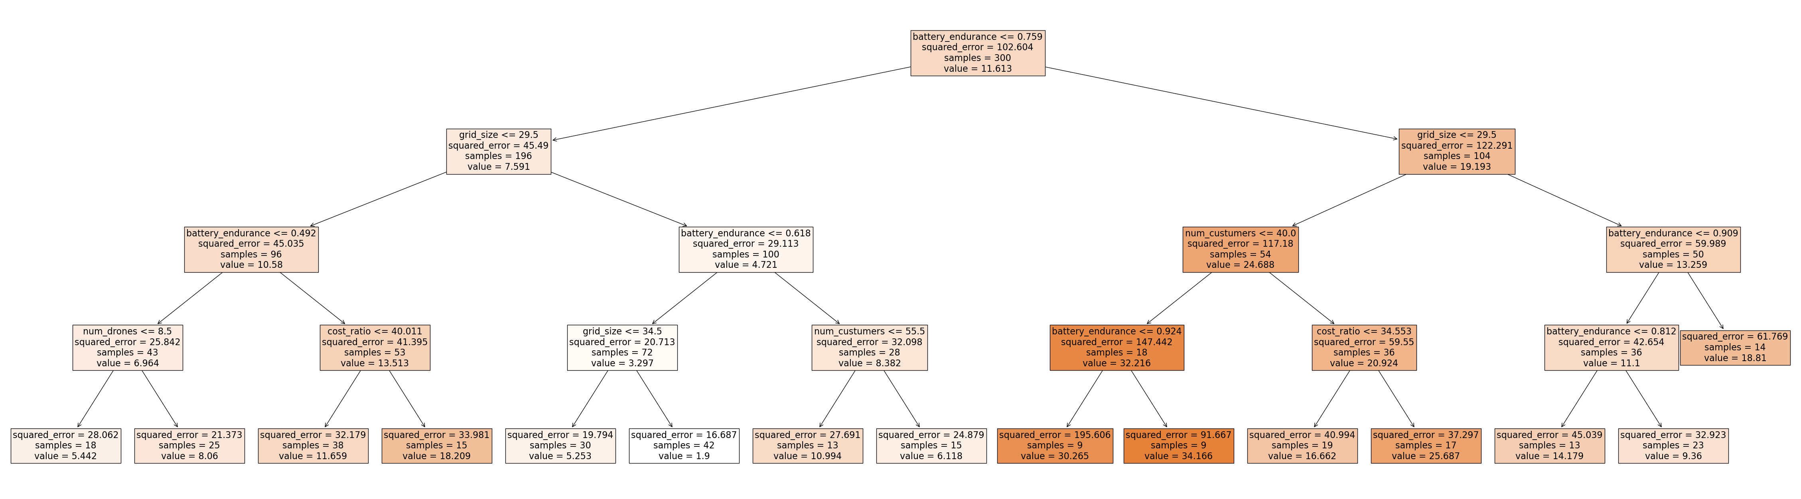
Experiments – Sensitivity analysis
Specifications
300 instances, 300 iterations for each instance (both with and without drones)
Max tree depth: 4, min n° of samples per leaf: 10
12th Gen Intel(R) Core(TM) i5-12450H @2.00 GHz
Observations
The endurance of the drones' batteries seems to be the most important parameter to guarantee a good advantage using drones

Slide 42
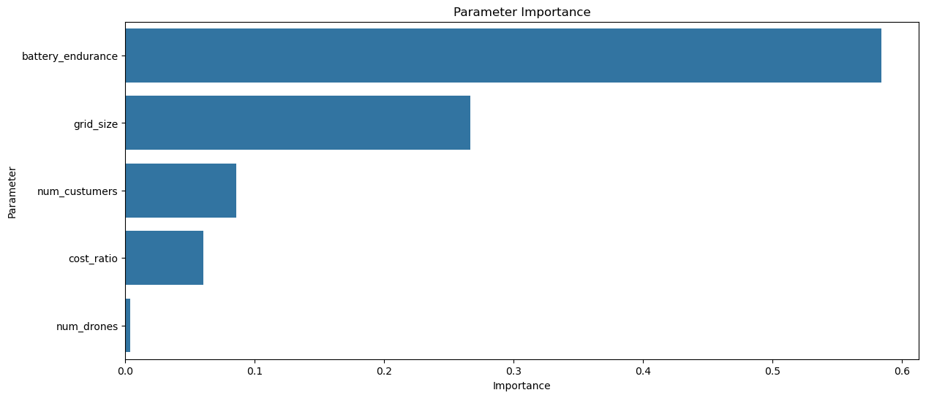
Experiments – Sensitivity analysis
The relative importance was computed as the normalized total reduction of impurity across all splits. The more important parameter tends to drive the higher impact on cost saving.

Slide 43
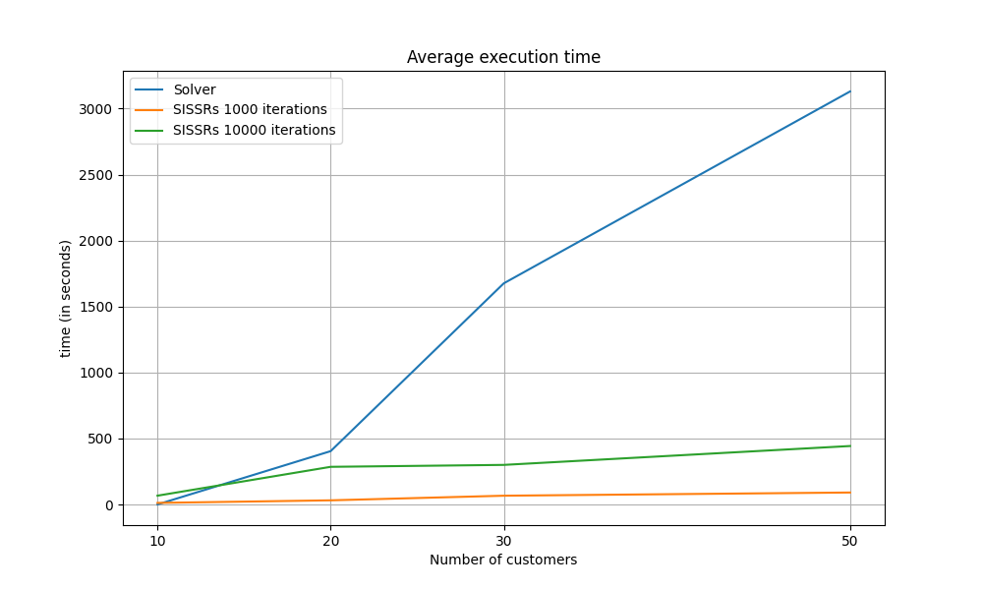
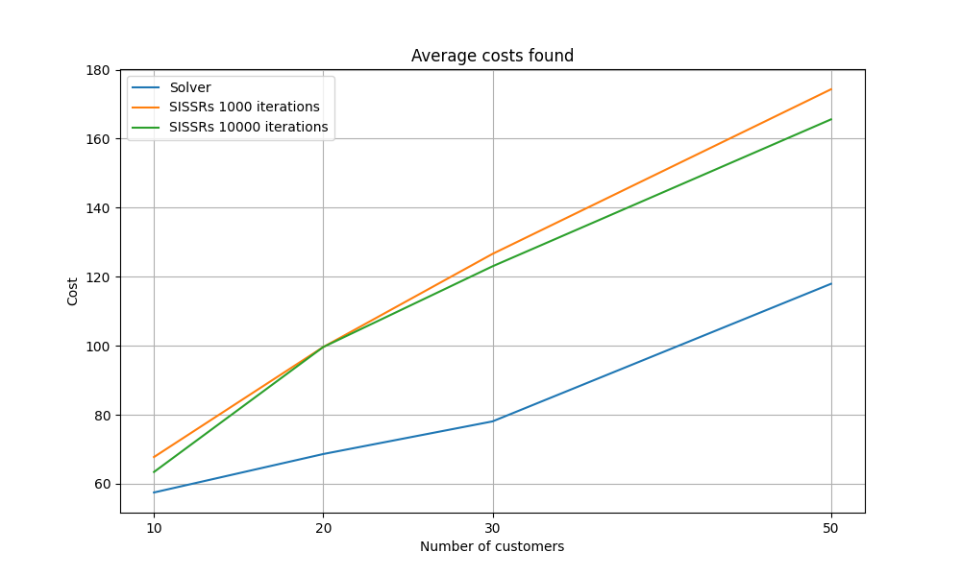
Experiments – Scalability test
36 instances
11th Gen Intel(R) Core(TM) i7-1165G7 @ 2.80GHz

Slide 44
Experiments – Min time variant
Specifications
9 instances of 30 customers
1000 iterations
11th Gen Intel(R) Core(TM) i7-1165G7 @ 2.80GHz
Observations
Depot in center positions leads to less service time
Instance | Service time (in hours) | SISSRs execution time (in seconds)
30-c-1-c | 0.98 | 193.44
30-c-1-e | 1.76 | 345.46
30-c-1-r | 1.23 | 214.53
30-r-1-c | 0.91 | 54.47
30-r-1-e | 1.80 | 344.92
30-r-1-r | 1.61 | 356.60
30-rc-1-c | 0.78 | 30.95
30-rc-1-e | 1.69 | 310.69
30-rc-1-r | 1.46 | 469.67

Slide 45
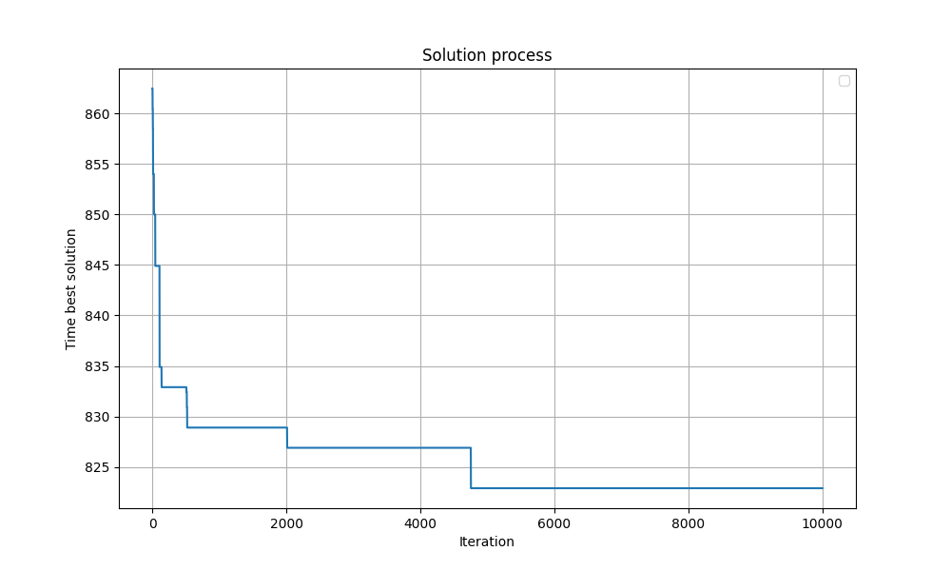
Experiments – Min time variant
1 instance of 101 customers (eil101)
11th Gen Intel(R) Core(TM) i7-1165G7 @ 2.80GHz
1 truck, 1 drone
80% of customers are drone eligible

Slide 46
Grazie
Federico Pellizzaro
Giovanni Zanin

Slide 47
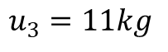
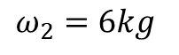
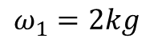
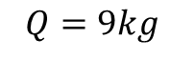
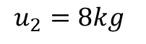
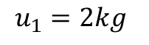
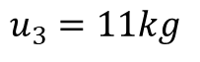
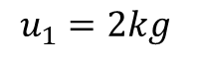
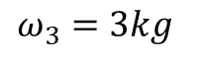
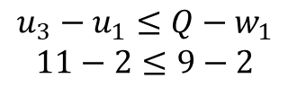
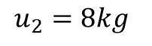
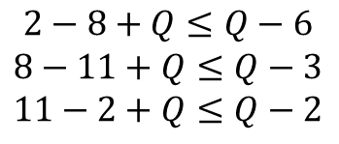
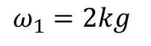
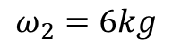
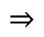


MILP – Formulation
Constraint 5 : examples
Subtour elimination
Capacity constraint
2
2
1
3
1
3
D
$$ω_{1}=2kg$$
$$u_{1}=2kg$$
$$ω_{1}=2kg$$
$$u_{1}=2kg$$
$$ω_{2}=6kg$$
$$u_{2}=8kg$$
$$ω_{2}=6kg$$
$$u_{2}=8kg$$
$$ω_{3}=3kg$$
$$u_{3}=11kg$$
$$ω_{3}=3kg$$
$$u_{3}=11kg$$
$$Q=9kg$$
$$2−8+Q≤Q−6$$
$$8−11+Q≤Q−3$$
$$11−2+Q≤Q−2$$
$$⇒$$
$$u_{3}−u_{1}≤Q−w_{1}$$
$$11−2≤9−2$$
$$⇒$$

Slide 48



String removal $l$ and $k_{s}$ analysis
Steps to find those params
average tour cardinality
→ max string cardinality overall
→ max n° of strings to remove
→ n° of strings to remove
→ max cardinality of string for tour $t$
→ cardinality of the string to be removed from tour $t$

Slide 49



Slack induction
Examples of insufficient and sufficient slack
Insufficient Slack
Sufficient Slack
unreachable
node

